Slide 1


Welcome
H! Drive
A Driver And Car Hiring App
ANMOL PATEL 2000290120027
AMAN VERMA 2000290120021
AKSHAT SINGH 2000290120018

Slide 2
App Development Using Kotlin
Driver Hiring App
01
About our system
02

Slide 3
Why H! Drive
Commonly we have seen this scenario that we plan a trip but due to unavailability of resource we have to cancel it. So H! Drive is the solution for this and will help people to hire a driver or a car for that purpose

Slide 4
Our System
H! Drive is an android app written on kotlin language.
It consist of Various contact detail of driver and available cars for that purpose.

Slide 5
Features
Driver Hiring
Car Hiring
Fare Calculator
List of Available cars
Driver Rating System
Feedback
Driver Driving Skills test

Slide 6
Languages
Kotlin
Tools
Android Studio

Slide 7
Future plan
We are thinking of some modifications and adding some advanced new features in out system. Some of them are –
Upgrading Mobile Application to implement (more user friendly) Application.
In future User can register himself for driving.
Also User can submit their available cars for rental purpose

Slide 8
User Interface

Slide 9
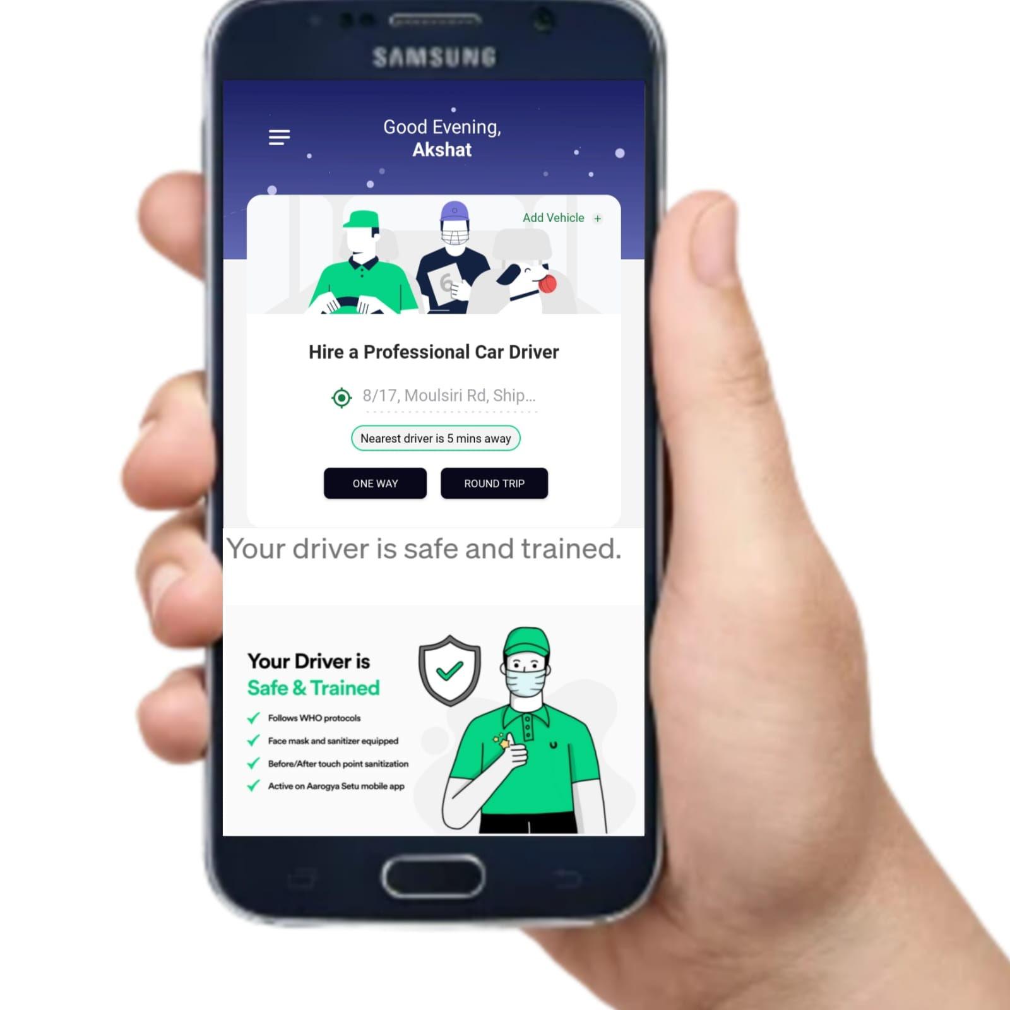

Slide 10
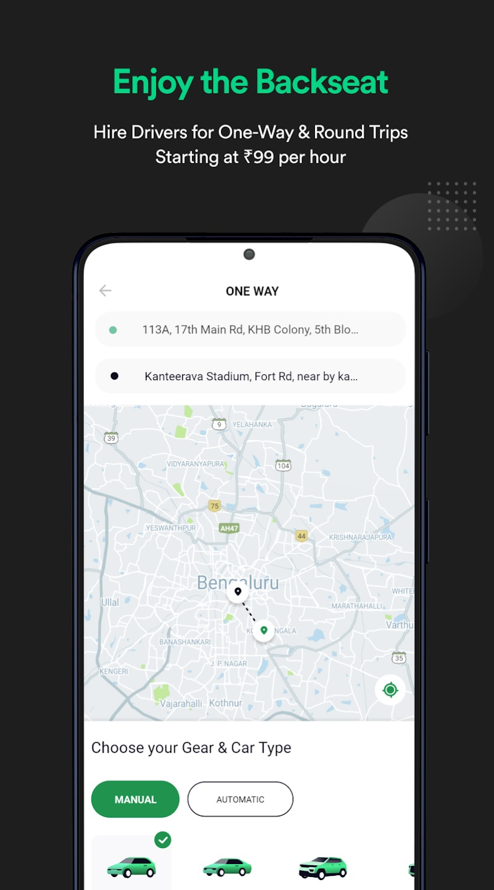

Slide 11
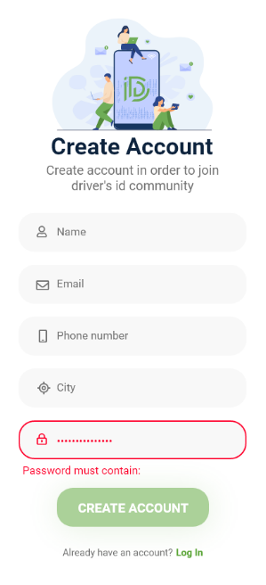

Slide 12
Thank you

